Slide 1
Chapter 6
Physical Design

Slide 2
Physical Design
As mentioned in Chapter 4, physical design is the process of adapting the logical design of the database to the actual DBMS.
The logical design can be adapted to meet the limitations and features of the chosen DBMS.

Slide 3
Choosing a DBMS
Many times you won’t have a choice of a DBMS; you will simply work with the one that is installed for your business.
But sometimes you may have to choose which DBMS to use.
When choosing a DBMS there are several things to consider.

Slide 4
Things to Consider When Choosing a DBMS
Compatibility with existing networks and systems
Hardware and software requirements for the DBMS
Features of the DBMS in relation to the data requirements
Familiarity and expertise in the DBMS by IT staff
Price and licensing
Product reliability and support

Slide 5
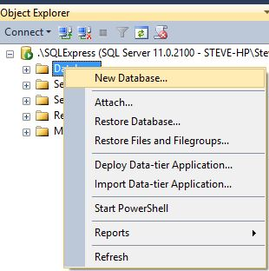
Creating a Database in SQL Server
The easiest way to create a new database is to right click on Databases in the Object Explorer and select “New Database.”

Slide 6
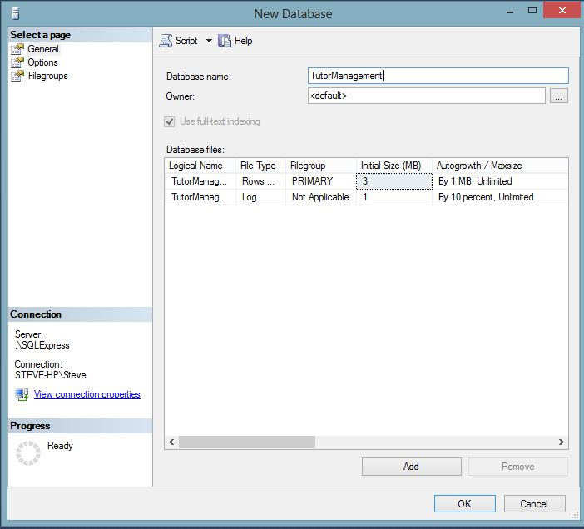
New Database Dialog
Notice that the database has two files: a Primary data file which stores all the data objects and the data, and a log file which logs transactions as they occur.

Slide 7
Data Types
In a Database Table every column must have a data type.
A data type determines what kind of values can be stored in a column.
Numeric data types can store only numbers.
Character data types can store words, numbers, and other characters.
There are several ANSI data types but each DBMS has their own variations and additions.

Slide 8
SQL Server Numeric Data Types
Data Type | Description | Range/Examples
bigint | 8 bytes integer | -2^63 (-9,223,372,036,854,775,808) to 2^63-1 (9,223,372,036,854,775,807)
int | 4 bytes | -2^31 (-2,147,483,648) to 2^31-1 (2,147,483,647)
smallint | 2 bytes | -2^15 (-32,768) to 2^15-1 (32,767)
tinyint | 1 byte | 0 to 255
bit | 1 bit | 0, 1 or Null
decimal | User can set precision up to 10^38 | decimal(10,2)
money | 8 bytes | -922,337,203,685,477.5808 to 922,337,203,685,477.5807
smallmoney | 4 bytes | - 214,748.3648 to 214,748.3647
numeric | User can set precision up to 10^38 | Same as decimal
float | Approximate numeric type, the number of bytes depends on number | - 1.79E+308 to -2.23E-308, 0 and 2.23E-308 to 1.79E+308
real | Also approximate, 4 bytes | - 3.40E + 38 to -1.18E - 38, 0 and 1.18E - 38 to 3.40E + 38

Slide 9
SQL Server Date Time Data Types
Data Type | Description | Examples/Range
date | New in 2008, stores date values | January 1, 1 A.D. through December 31, 9999 A.D.
datetime2 | New: Stores date and time and allows user to set precision in fractions of seconds | Same date range as above. Time range=00:00:00 through 23:59:59.9999999
datetimeoffset | Date and time but with time zone awareness | same
smalldatetime | Smaller date time type | January 1, 1753, through December 31, 9999 00:00:00 through 23:59:59.997
time | New, you can set the precision in fractions of a second | 00:00:00.0000000 through 23:59:59.9999999

Slide 10
SQL Server Character Data Types
Data Type | Description | Examples
char | Fixed length ASCII text | “Jefferson” – max 255 characters
text | Text stores large blocks of text data. The text and ntext data types are deprecated, use varchar(MAX) or nvarchar(MAX) | 2,147,483,647 bytes
varchar | Variable length ASCII | “Los Angeles,” Maximum 255 characters unless MAX (MAX allows 2^31-1 bytes)
nchar | Unicode fixed length | Uses Unicode UCS_2 character set
ntext | Unicode large block. Deprecated
nvarchar | Unicode variable length text

Slide 11
Unicode
Unicode is an extended character set that includes non-Latin character sets such as Russian or Japanese.
It is built into every newer computer.

Slide 12
SQL Server Other Data Types
Data type | Description | Examples
image | Variable length binary data. The image data type is deprecated and will go away. | 2^31-1 bytes
binary | Fixed length binary | 1 to 8000 bytes
varbinary | Variable length binary | 1 to 8000 bytes unless you specify MAX, 2 ^31-1 bytes
uniqueidentifier | Generates a unique identifier | 6F9619FF-8B86-D011-B42D-00C04FC964FF
xml | Stores XML data as XML, can be validated against schema collections, queried with xquery | <employee> <name>Sue Larson</name> </employee>

Slide 13
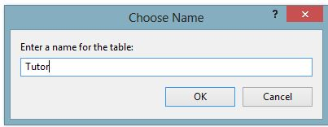
Creating a Table
One way to create a table is:
Right click on the tables folder in the database
Choose new table
Enter the fields and data types
Save and name the table

Slide 14
Nulls
A null is an important concept in databases.
A null represents the absence of a value, an unknown value.
As such it is not equivalent to a 0 or an empty string “”.
Nulls are ignored by most aggregate functions such as count, sum, and average.
You have a choice when designing a table to allow it to accept nulls or not.

Slide 15
Creating a Table with SQL
You can also create a table with SQL:
CREATE TABLE Course
(
CourseKey NCHAR(10) PRIMARY KEY,
CourseName NVARCHAR(50) NOT NULL,
CourseDescription NVARCHAR(200) NULL
)

Slide 16
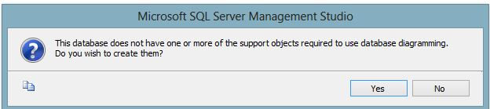
Database Diagram
To create a database diagram, right click on the database diagram folder under the database.
You will receive a message like the following:

Slide 17
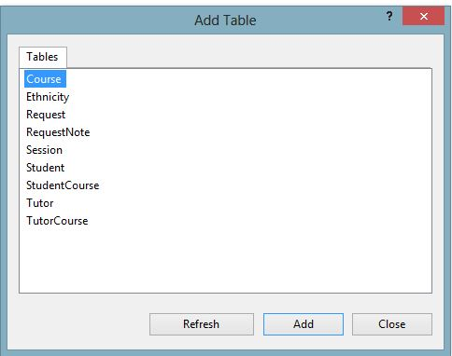
Database Diagram Cont.
Click the yes button. An Add tables Dialog box appears:

Slide 18
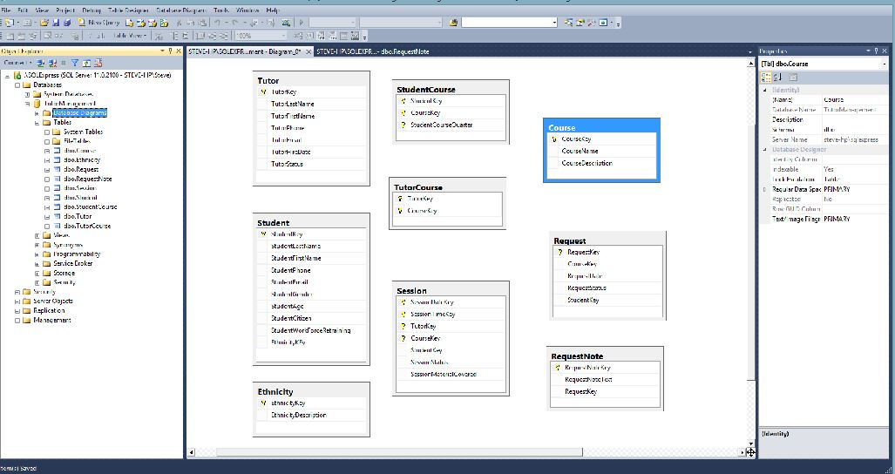
Database Diagram Cont.

Slide 19
Creating Relationships
One way to create relationships in SQL Server is to select a primary key column in the parent table and drag the mouse to the matching field in the child table.
This will bring up the relationship dialog.

Slide 20
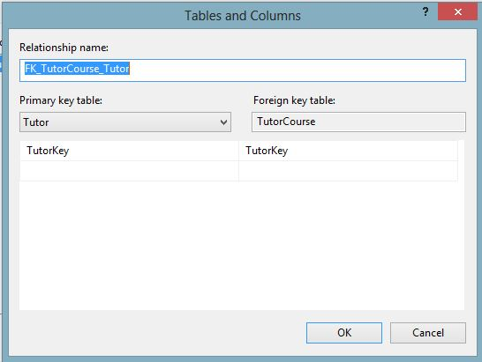
Relationship Dialog
Make sure the tables and columns are correct.

Slide 21
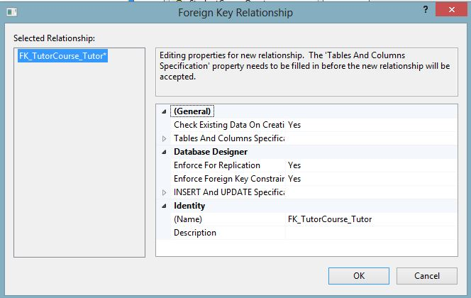
Foreign Key Relationship Dialog
Next you can set properties for the relationship.

Slide 22
Referential Integrity
Referential integrity results from enforcing the foreign key constraint.
Enforcing it means that there can be no foreign key value in the child table that does not exist as a primary key value in the parent table.
Enforcing referential integrity prevents orphan records, for instance, an order that has no customer making the order.

Slide 23
Effects of Enforcing Referential Integrity
Action | Effect of Enforcing Referential Integrity
INSERT | You must enter data into the parent (primary key) table before you can enter data into a child (foreign key) table. Example: You must enter the customer information before entering the sale information.
UPDATE | You cannot change the primary key value for any record in the parent table without also changing the related foreign key. This creates a dilemma because both must be changed simultaneously. You can either suspend referential integrity while making the update or use Cascading Updates (see below). You can only update or change a foreign key in a child table to one that has a matching value in a parent or primary key table.
DELETE | You cannot delete a row in a primary key table unless all related records are first deleted in the foreign key table. Example: you can’t delete an order unless all the order details for that order are first deleted.

Slide 24
Sample Data
Once the tables are complete, it is a good idea to enter some sample data in order to test the database.
Make sure your sample data (are):
Complete enough to test the data
Varied enough to represent a variety of likely scenarios
Contain some exceptions and perhaps even some errors in order to test how your database handles them

Slide 25
Documentation
In many ways the database is self documenting.
System tables keep the “meta” information tables and other objects.
But it is useful to keep a separate data dictionary that describes all tables, columns, data types, and constraints.

Slide 26

All rights reserved. No part of this publication may be reproduced, stored in a retrieval system, or transmitted, in any form or by any means, electronic, mechanical, photocopying, recording, or otherwise, without the prior written permission of the publisher. Printed in the United States of America.

